Slide 1
Tracking Dataset Analysis and Documentation
Made by Dev Shinde

Slide 2
Proposed System
Here we have created a dataset in which we will find the risk status of the travellers during their tracking.
We have created this data in order to analyse the information about the travellers and analyse their information to determine their risk status
We will also use several conditions in order to create several bar and pie charts for graphical and visual representation.

Slide 3
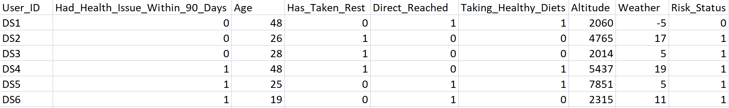
System Flowchart
We have created several columns that defines the features of the Data set.

Slide 4
We have created different columns describing different features inside the database.
Like Age,Weather, Altitude, Has_taken_rest, Diet.
We can we this information to determine the Risk Status of the trackers.
With this information we can get a lot of insights into data and we can find several cases of data through it.

Slide 5
Here if a person’s Age is more the 50 then the person might not have the power to climb so high so the person will be at Risk
Also if a person had health issues within 90 days; then there might be chances that his body might not function well during tracking so the person will be at risk status
And if a person does not follow a healthy diet; so there may be a chance of health issues so the person is at risk

Slide 6
Begining the process
Reading the excel file
System Flowchart
Data Preprocessing
Processing Analytical
information
Applying KNN Algorithm
Finding Accuracy of the model by elbow method
Along with it we also find precision , F1 score and
Confusion Matrix
Applying Data Visualization
Plotting Data in Different Graphs such as bar,pie,scatter
End of the Process

Slide 7
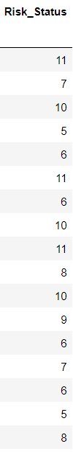
Analytical Information
Here as you can see by using Groupby
we can calculate analytical information
of all ages like from Age 18-34
What was the total risk status per age
Group

Slide 8
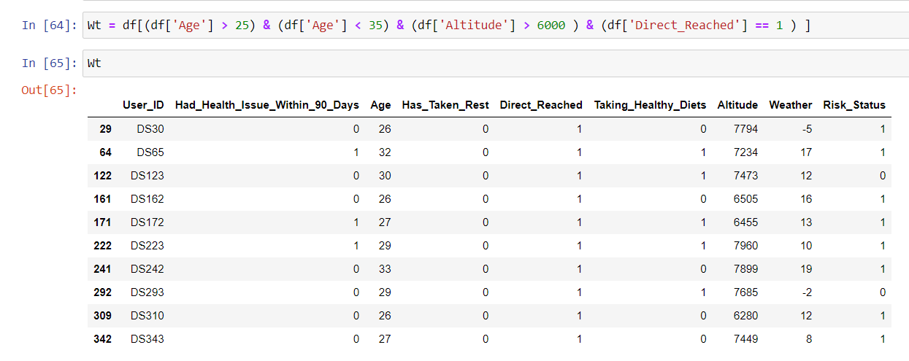
Also you can see here that we have
created a table in which we have
arranged from Age = (25 to 30)
Trackers climbed altitude greater than
6000
And they reached directly without
taking rest

Slide 9
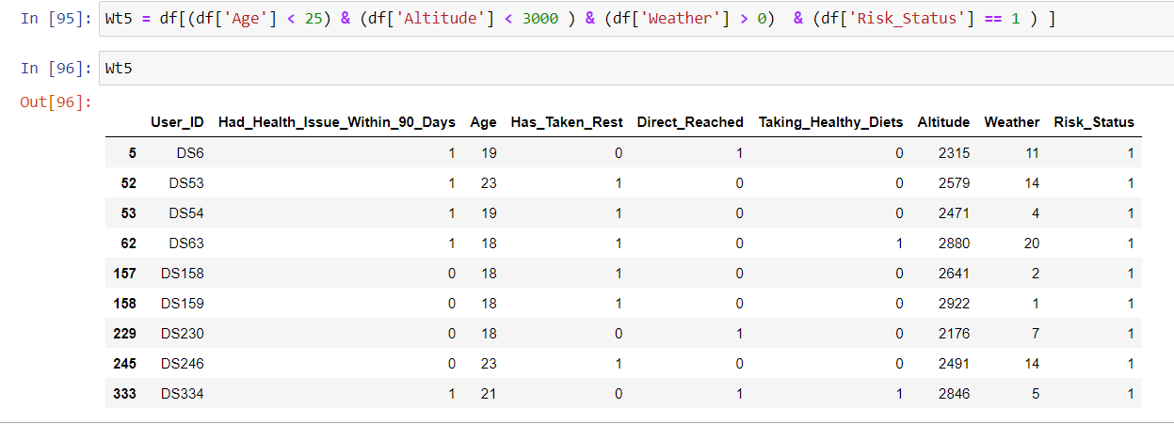
Here we have created a list in which we can see age of persons is less than 25
and altitude is also less than 3000 and weather is also greater than 0 still they are at risk

Slide 10
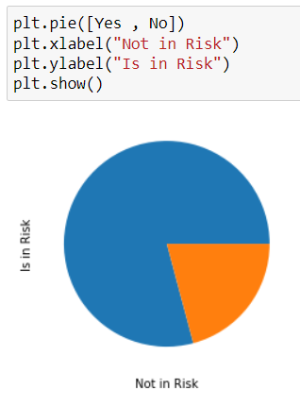
Visual Scenerio
Here we can see we have created visual
representation about how much people are at
risk and how much are not in risk status

Slide 11
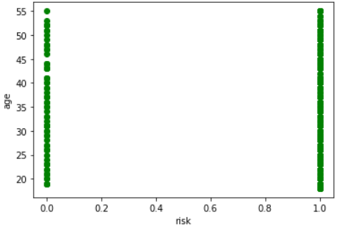
Here we have created a scatter plot in
which we have represented age and risk
plot . and we have reprented all persons
and their risk and not risk status according
to their age

Slide 12
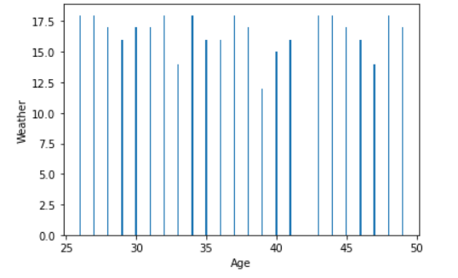
Here have arranged weather from 0 to 18 degree celcius and age from 25 to 50
and we have drawn bar graph of it.

Slide 13
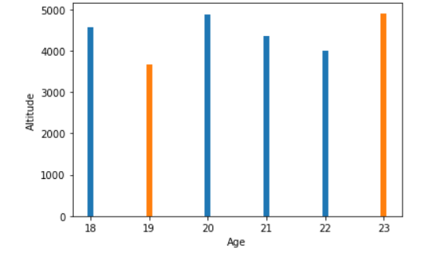
Here we have performed a subplot graph in which we have taken
Altitude from 1000 to 5000 and age form 18 to 23 and blue represent a person
having risk status and orange represent a person having no risk status

Slide 14
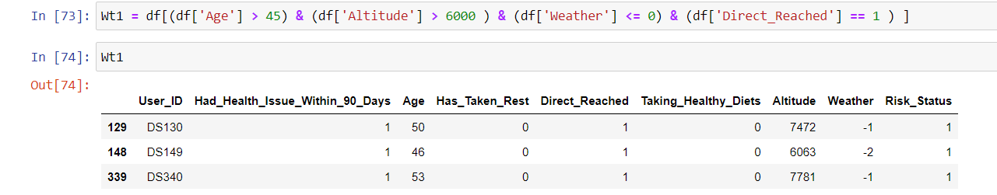
Insights
By looking at this data we got an insight that there are no person who
age is greater than 45 who has gone to Altitude greater than 6000 and Weather below 0
and has reached directly.

Slide 15
Persons who have issues within 90 days and didn’t take
A healthy diet was absolutely at risk status.
People below age 50 and taking a healthy diet and not having health issues within 90 days were not at risk.
Persons whose age was above 50 were absolutely at risk.
Mostly persons above age 48 had taken rest even if altitude less than 4000.

Slide 16
Inference
By doing all this analysis we can conclude that we have to
definitely make some improvements in the system like
not allowing persons above 50 and advise persons over 45 take rest and advise them to take healthy diet in order to remain out of risk status

Slide 17
At the End
I will say thank you
for giving your valuable time

